Slide 1

CS4HS Game-Dev in High Schools
Steve Rodkiss

Slide 2

Why?
NCEA’s ‘project based’ learning potential and the increase focus on teaching relevant, engaging topics that cover DDDO and CT mean that Game Development is a good fit.
Work smart, not hard (Steve Rodkiss)
How?

Slide 3
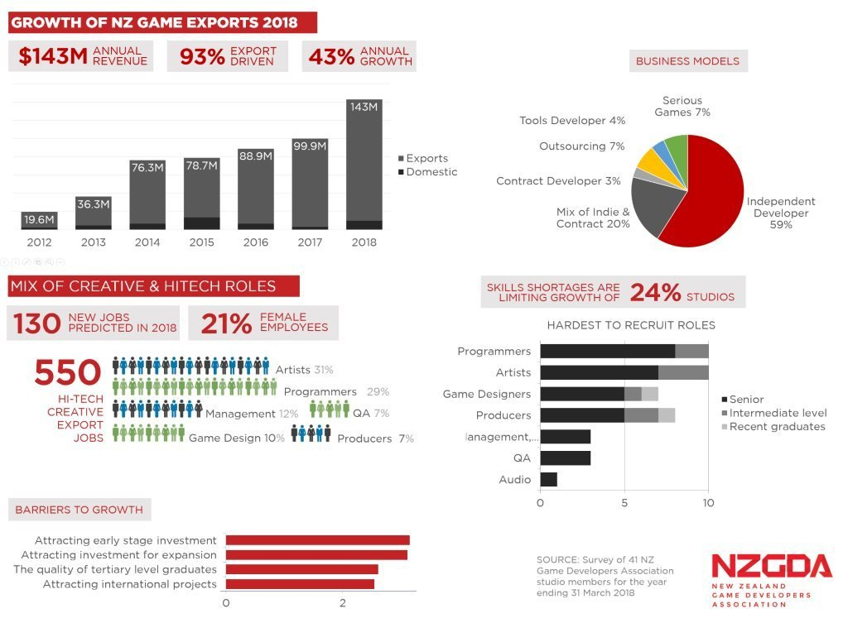
Why?

Slide 4
How does it all fit?
Week | Term 1 | Term 2 | Term 3 | Term 4
1 | Introduction | Hand in 91878: Develop a design for a digital outcome and Proposal Due (06/5/22) | Check off Sprint #2 review, Start Sprint #3 | Dev Log tidy up Design Portfolio
2 | Godot Learning #1 | Sprint #1- Start | Sprint #3 | Development Log’s Marked by here!
3 | Godot Learning #2 | Sprint #1 | Sprint #3 | NCEA Starts
4 | Godot Learning #3 | Sprint #1 | Sprint #3 Hand in
5 | Godot Learning #4 | Sprint #1 delivery at end of week | Final testing and Final Evaluation
6 | Godot Learning #5 | Public testing of sprint #1 Sprint retrospective Plan for sprint 2 (signed off) Sprint#1 Hand in 18/6/21 | External Study: HCI
7 | Proposal + Design | Sprint #2 | Practise DCAT last period
8 | Proposal + Design | Sprint #2 | Senior Exams HCI Exam
9 | Proposal + Design | Sprint #2- Last week | Development Log tidy up and editing and peer review Bright Awards
10 | Proposal + Design | Public Test #2 Sprint Retrospective + Log Hand in | Development Log #4 final hand in and Marking
11 | Proposal + Design

Slide 5
And that is…..?
AS91877- Develop a proposal for a digital outcome | 3 Credits
AS91878- Develop a design for a digital outcome | 3 Credits
AS91884- Use basic iterative processes to develop a digital outcome | 6 Credits
AS91880- Develop a digital media outcome | 4 Credits
AS91883- Develop a computer program (optional) | 4 Credits
AS91047- Develop a prototype (optional) | 6 Credits
AS91886- HCI External | 3 Credits
Total | 19 (29)

Slide 6
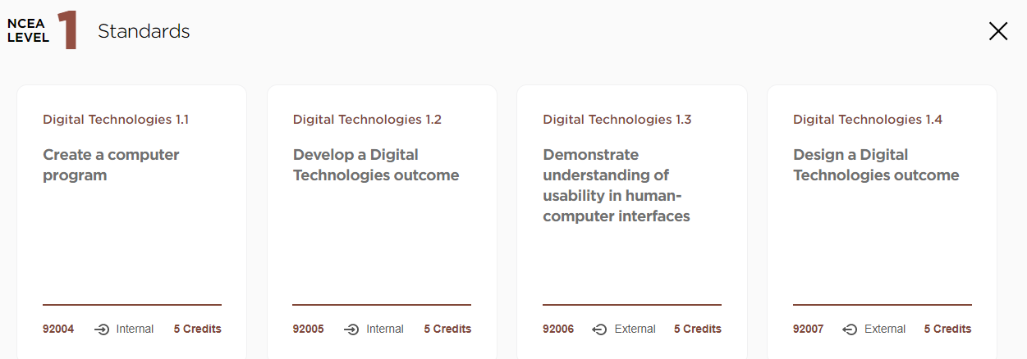
How about the new standards?
Manaakitanga: Design from the user experience point of view. HCI, MDA, Conventions
Kaitiakitanga: Design for the good of all. Legal, health and safety, ethical, moral

Slide 7
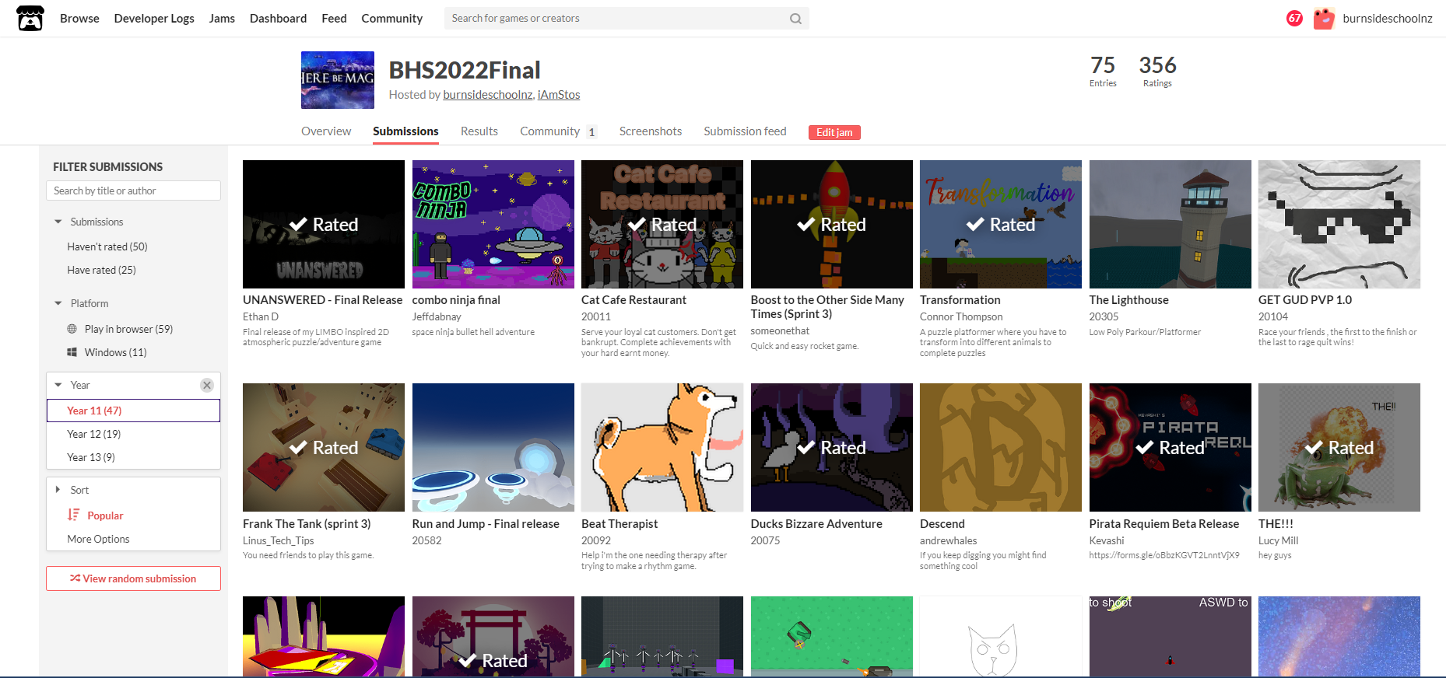
The kids see……..

Slide 8


What and Why?
Junior- GDevelop
Senior- Godot (NOT Unity!!)
Also: Piskel, Inkscape, Blender, Gimp, Audacity, JFXR
And: Soundbible, Kenney.nl, itch.io etc…..
Can you tell I’m Scottish?

Slide 9
Resources
https://github.com/SteveRodkiss/CS4HSAUT22
https://sites.google.com/burnside.school.nz/bhs-digital-technologies/year-11/11dtg

Slide 10
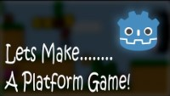
Demo Time!

Slide 11
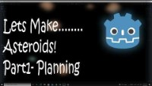
Demo Time!

